Slide 1
Features of linear relationships
Graphical representations of linear equations

Slide 2
how to use Oak lessons

Slide 3
I can recognise that linear relationships have particular algebraic and graphical features as a result of the constant rate of change.

Slide 4
The relationship between two variables is linear if, when plotted on a pair of axes, a straight line is formed.

Slide 5

Features of a linear relationship
The constant rate of change
Graphical and algebraic representations

Slide 6
The constant rate of change
Calculate the first five terms of these sequences.
2n
n + 3
Term number (n) | 1 | 2 | 3 | 4 | 5
Term value (T)
Term number (n) | 1 | 2 | 3 | 4 | 5
Term value (T)
Term number (n) | 1 | 2 | 3 | 4 | 5
Term value (T) | 2 | 4 | 6 | 8 | 10
Term number (n) | 1 | 2 | 3 | 4 | 5
Term value (T) | 4 | 5 | 6 | 7 | 8
n²
n³
Term number (n) | 1 | 2 | 3 | 4 | 5
Term value (T) | 1 | 4 | 9 | 16 | 25
Term number (n) | 1 | 2 | 3 | 4 | 5
Term value (T) | 1 | 8 | 27 | 64 | 125
Term number (n) | 1 | 2 | 3 | 4 | 5
Term value (T)
Term number (n) | 1 | 2 | 3 | 4 | 5
Term value (T)
What common feature do 2n and n + 3 share that n² and n³ do not?

Slide 7
The constant rate of change
2n and n + 3 are arithmetic (linear). A constant difference between terms.
2n
n + 3
Term number (n) | 1 | 2 | 3 | 4 | 5
Term value (T) | 2 | 4 | 6 | 8 | 10
Term number (n) | 1 | 2 | 3 | 4 | 5
Term value (T) | 4 | 5 | 6 | 7 | 8
+2
+2
+2
+2
+1
+1
+1
+1
n²
n³
Term number (n) | 1 | 2 | 3 | 4 | 5
Term value (T) | 1 | 4 | 9 | 16 | 25
Term number (n) | 1 | 2 | 3 | 4 | 5
Term value (T) | 1 | 8 | 27 | 64 | 125
+3
+5
+7
+9
+7
+19
+37
+61

Slide 8
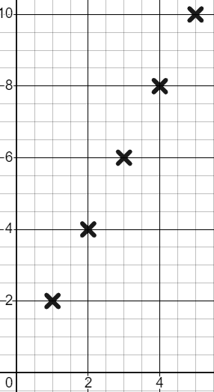
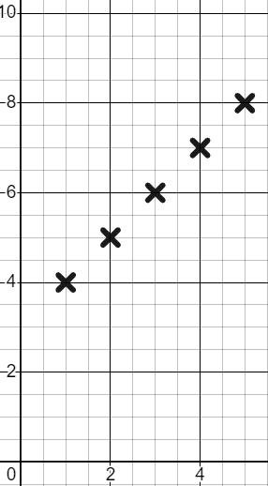
The constant rate of change
We can see that constant difference when we plot these sequences.
2n
n + 3
Term number (n) | 1 | 2 | 3 | 4 | 5
Term value (T) | 2 | 4 | 6 | 8 | 10
Term number (n) | 1 | 2 | 3 | 4 | 5
Term value (T) | 4 | 5 | 6 | 7 | 8
T
+2
+2
+2
+2
T
+1
+1
+1
+1
The constant difference makes the points form a line, hence the term ‘linear’.
n
n

Slide 9
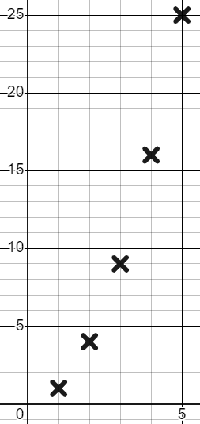
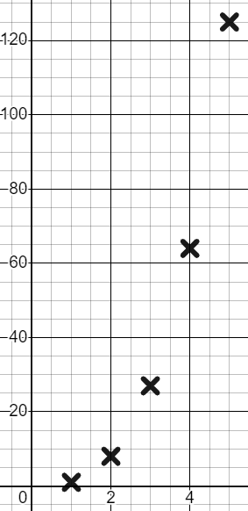
The constant rate of change
T
T
By contrast…
We can see that n² and n³ are non-linear.
n
n
n²
n³
Term number (n) | 1 | 2 | 3 | 4 | 5
Term value (T) | 1 | 4 | 9 | 16 | 25
Term number (n) | 1 | 2 | 3 | 4 | 5
Term value (T) | 1 | 8 | 27 | 64 | 125
+3
+5
+7
+9
+7
+19
+37
+61

Slide 10
The constant rate of change
Will this look any different if we plot algebraic relationships?
y = 2x
y = x + 3
y = x²
x | 0 | 1 | 2 | 3 | 4
y
x | 0 | 1 | 2 | 3 | 4
y | 0 | 2 | 4 | 6 | 8
x | 0 | 1 | 2 | 3 | 4
y
x | 0 | 1 | 2 | 3 | 4
y | 3 | 4 | 5 | 6 | 7
x | 0 | 1 | 2 | 3 | 4
y
x | 0 | 1 | 2 | 3 | 4
y | 0 | 1 | 4 | 9 | 16
+2
+2
+2
+2
+1
+1
+1
+1
+1
+3
+5
+7
Constant difference
Constant difference
Not constant

Slide 11
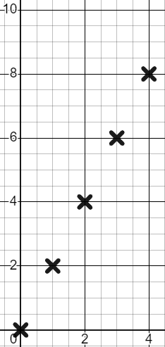
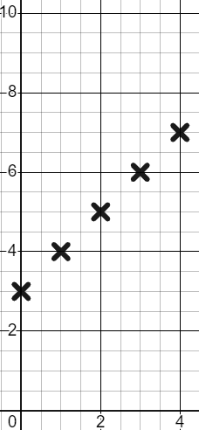
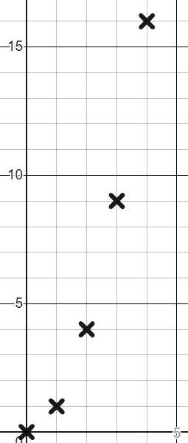
The constant rate of change
Will this look any different if we plot algebraic relationships?
y = 2x
y = x + 3
y = x²
x | 0 | 1 | 2 | 3 | 4
y | 0 | 2 | 4 | 6 | 8
x | 0 | 1 | 2 | 3 | 4
y | 3 | 4 | 5 | 6 | 7
x | 0 | 1 | 2 | 3 | 4
y | 0 | 1 | 4 | 9 | 16
y
A linear relationship
y
A linear relationship
y
Non-linear
x
x
x

Slide 12
The constant rate of change
What is it that determines whether a sequence or relationship is linear or not?
Linear
Non-linear
Linear relationships have an exponent of 1.
2n
n + 3
n²
n³
y = 2x
y = x²
y = x + 3
Exponent of 1
Exponents not 1
Spot the difference!

Slide 13

The constant rate of change
Which of these sequences will have a constant difference?
The n exponent is 1. This will be an arithmetic (linear) sequence with a constant difference.
The exponent of n is not 1. Not linear.
The n exponent is 1. This will be an arithmetic (linear) sequence with a constant difference.
The exponent of n is not 1. Not linear.
4n + 6
n² − 7
7 − 4n
5n⁶

Slide 14
The constant rate of change
Which of these relationships will be linear?
The x and y exponents are 1. Linear relationship.
The exponent of x is not 1. Not linear.
Both x and y exponents have to be 1. This will not be linear.
The x and y exponents are 1. Linear relationship.
y = 3x + 8
y = 3x³ + 8
y² = 3x + 8
1 − 3x = y

Slide 15

The constant rate of change
Alex starts with 2 sweets. Every day he is given 3 more.
This will form an arithmetic sequence.
Term number (n) | 1 | 2 | 3 | 4 | 5
Term value (T) | 2 | 5 | 8 | 11 | 14
Term number (n) | 1 | 2 | 3 | 4 | 5
Term value (T) | 2
+3
+3
+3
+3
The arithmetic (linear) sequence 3n − 1 with a constant difference of +3

Slide 16


The constant rate of change
The arithmetic (linear) sequence 3n − 1 with a constant difference of +3
Term number (n) | 1 | 2 | 3 | 4 | 5
Term value (T) | 2 | 5 | 8 | 11 | 14
Term number (n) | 1 | 2 | 3 | 4 | 5
Term value (T) | 2
+3
+3
+3
+3
With a visual representation of the sequence we can see that constant difference of +3

Slide 17
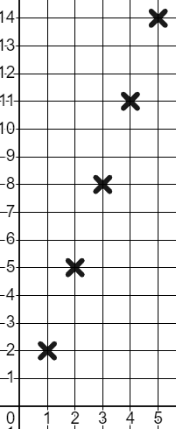
The constant rate of change
y
Will we see something similar when we plot the algebraic relationship y = 3x − 1 ?
x | 1 | 2 | 3 | 4 | 5
y | 2 | 5 | 8 | 11 | 14
x | 1 | 2 | 3 | 4 | 5
y
+3
+3
+3
+3
x

Slide 18
The constant rate of change
y
y = 3x − 1
+1
+1
+1
+1
+3
x | 1 | 2 | 3 | 4 | 5
y | 2 | 5 | 8 | 11 | 14
x | 1 | 2 | 3 | 4 | 5
y
+1
+3
+1
+3
+3
+3
+3
+3
The relationship between two variables is linear when they change together at a constant rate.
+1
+3
+1
x

Slide 19
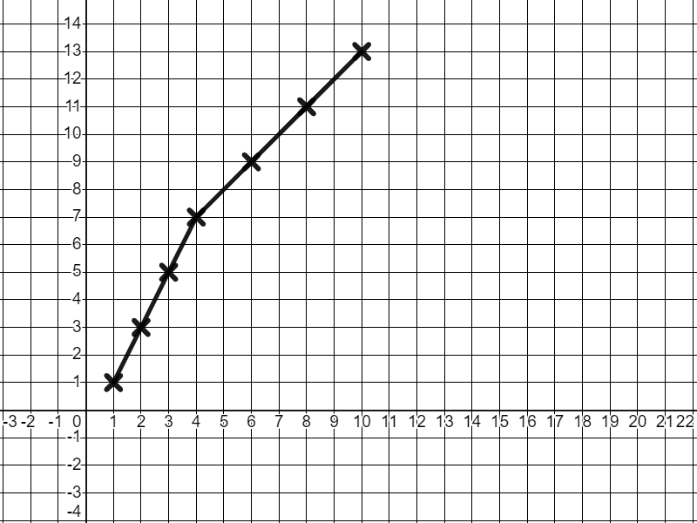
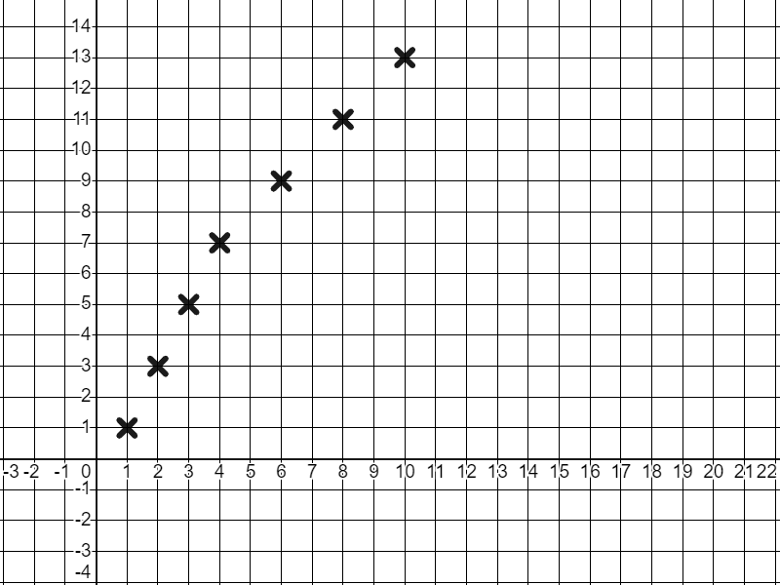
The constant rate of change
No.
Not a straight line therefore not linear.
Our definition of linear is:
Does this set of coordinates have a linear relationship?
+1
+1
+1
+2
+2
+2
y
x | 1 | 2 | 3 | 4 | 6 | 8 | 10
y | 1 | 3 | 5 | 7 | 9 | 11 | 13
+2
+2
+2
+2
+2
+2
The relationship between two variables is linear when they change together at a constant rate.
x

Slide 20
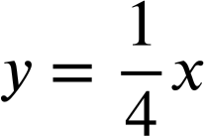
The constant rate of change
1) Classify these relationships into linear and non-linear.
y = 0.4x
y = x^{0.4}
y = 4x²
y = x + 4
Linear
Non-linear
y = 4x
4y = x
y = 2x⁴
y⁴ = x + 4
x + y = 4
y = x⁴ + 4

Slide 21
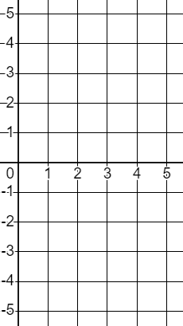
The constant rate of change
2) Plot the coordinates for these relationships for the given range of x values and show graphically their constant rate of change.
y
a)
b)
y = 2x − 5
x | 1 | 2 | 3 | 4 | 5
y
x
y = 3 − x
x | 1 | 2 | 3 | 4 | 5
y

Slide 22
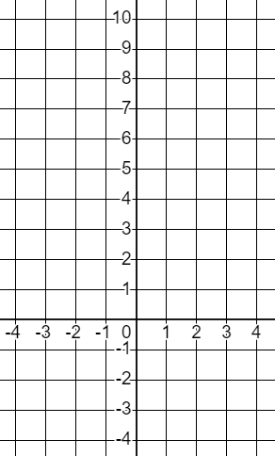
The constant rate of change
y
3) This set of coordinates has a linear relationship with a constant rate of change.
Find the missing values, plot the graph, and show the constant rate of change.
x | −4 | −2 | 0 | 2 | 4
y | −3 |  |  |  | 9
x

Slide 23
The constant rate of change
1) Classify these relationships into linear and non-linear.
Linear
Non-linear
y = 4x
y = x + 4
y = 4x²
y⁴ = x + 4
4y = x
x + y = 4
y = 2x⁴
y = x⁴ + 4
y = 0.4x
y = x^{0.4}
Exponent of 1
Exponents not 1

Slide 24
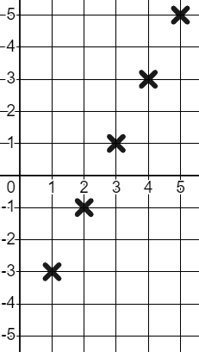
The constant rate of change
2) Complete the table for the given range of x values. Plot the relationships and show on the graph their constant rate of change.
y
y = 2x − 5
+2
a)
x | 1 | 2 | 3 | 4 | 5
y | −3 | −1 | 1 | 3 | 5
x | 1 | 2 | 3 | 4 | 5
y
+1
+2
+1
x
+2
Because of the constant rate of change this is a linear relationship.
+1
+2
+1

Slide 25
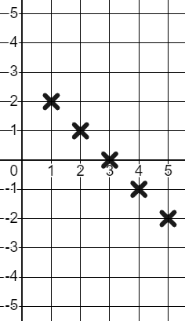
The constant rate of change
2) Plot the coordinates for these relationships for the given range of x values and show graphically their constant rate of change.
y
b)
Because of the constant rate of change this is a linear relationship.
+1
−1
x
y = 3 − x
x | 1 | 2 | 3 | 4 | 5
y | 2 | 1 | 0 | −1 | −2
x | 1 | 2 | 3 | 4 | 5
y

Slide 26
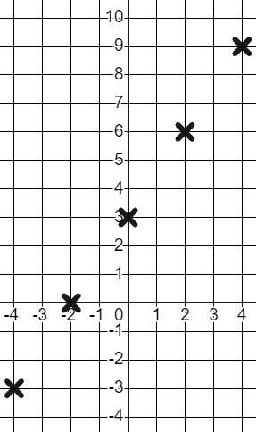
The constant rate of change
y
3) This set of coordinates has a linear relationship with a constant rate of change.
Find the missing values, plot the graph, and show the constant rate of change.
+3
+2
+2
+2
+2
+2
+3
+2
x | −4 | −2 | 0 | 2 | 4
y | −3 | 0 | 3 | 6 | 9
x | −4 | −2 | 0 | 2 | 4
y | −3 |  |  |  | 9
+3
x
+2
+3
+3
+3
+3
+3
Constant rate of change makes a linear relationship.
+2

Slide 27
Features of a linear relationship
The constant rate of change
Graphical and algebraic representations

Slide 28
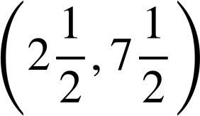
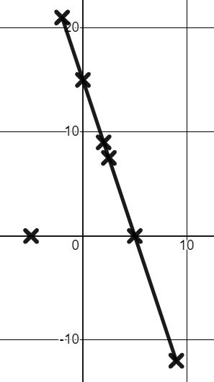
Graphical and algebraic representations
All of these coordinates fit the relationship y = 15 − 3x except for one.
(0, 15)
(2, 9)
(−5, 0)
(−2, 21)
(9, −12)
y = 15 − 3x
= 15 − 3(−5)
= 15 + 15 = 30
The coordinate that does fit the relationship will not be part of the linear pattern.

Slide 29
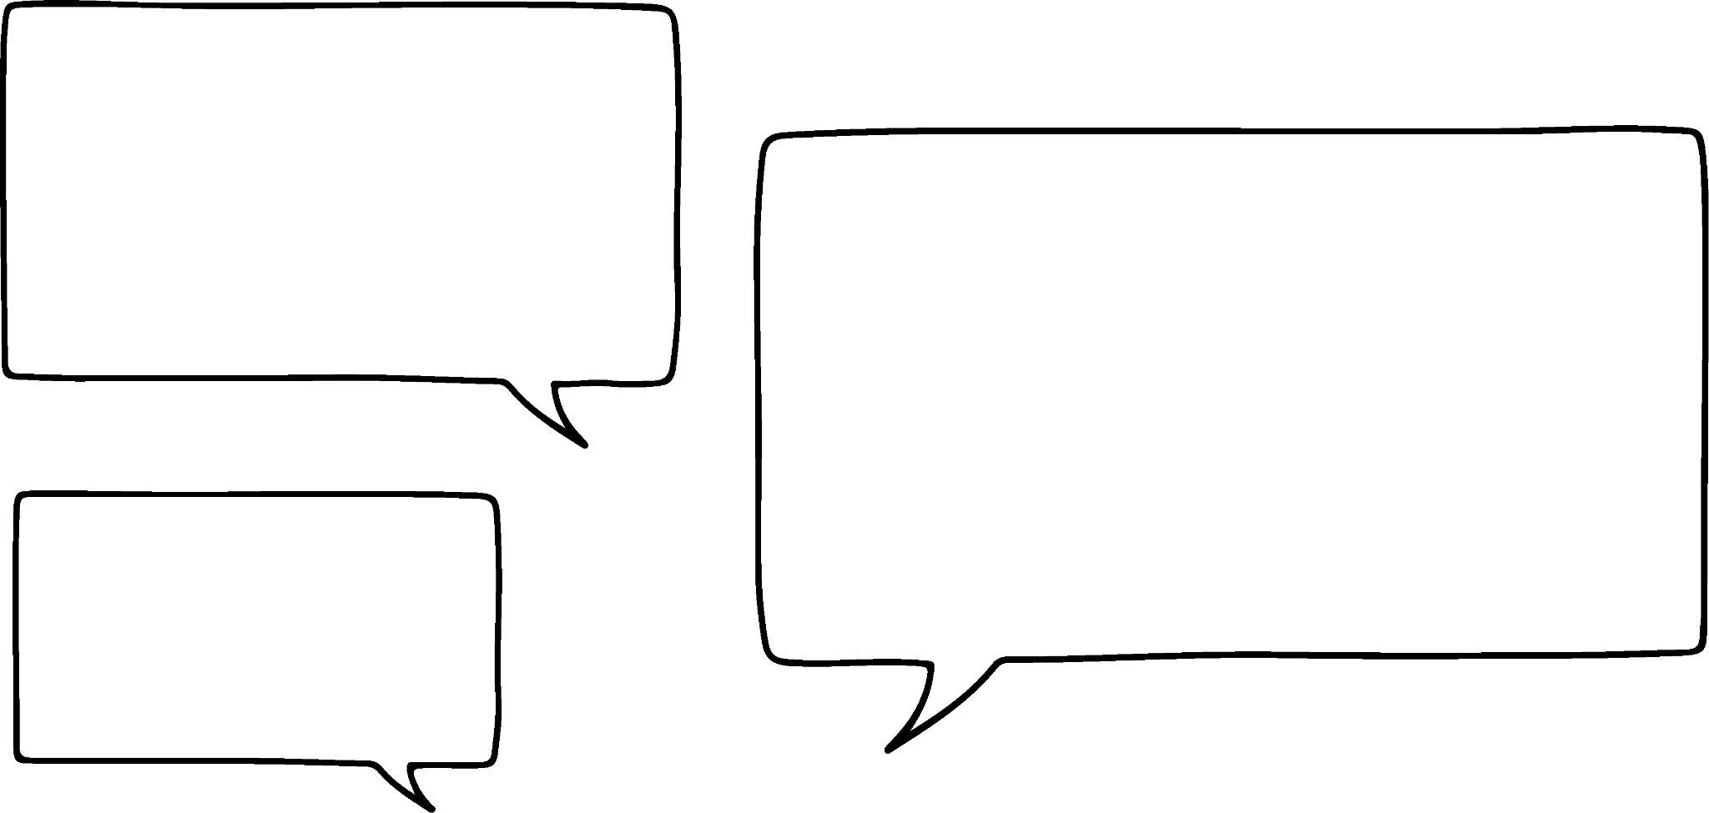



Graphical and algebraic representations
Some pupils are discussing a coordinate.
(2, 5)
Who is right?
I think there is a linear relationship y = x + 3
I think there is a linear relationship y = 7 − x
I think there is a linear relationship y = 2x + 1
Jacob
Aisha
Sofia

Slide 30
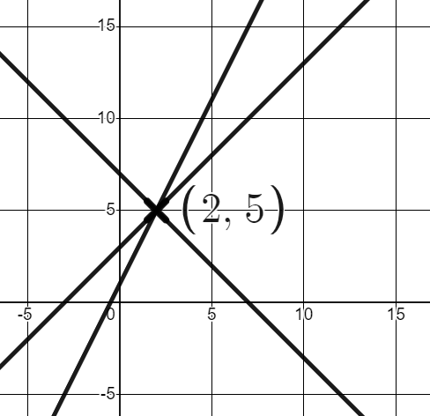
Graphical and algebraic representations
They might all be right!
(2, 5)
But what if we knew a 2nd coordinate?
(−5, 12)
y = x + 3
y = 7 − x
y = 2x + 1
Jacob
Aisha
Sofia

Slide 31
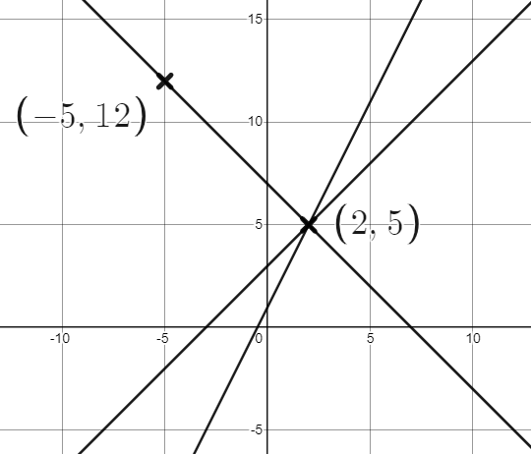
Graphical and algebraic representations
It is now only Aisha’s relationship that works for both coordinates.
(2, 5)
(−5, 12)
y = x + 3
y = 7 − x
y = 2x + 1
Jacob
Aisha
Sofia

Slide 32
Graphical and algebraic representations
The coordinate (6, 13) belongs to which linear relationship?
y = 3x − 5
3(6) − 5 = 13
y = x + 7
(6) + 7 = 13
y =2x + 1
2(6) + 1 = 13

Slide 33

Graphical and algebraic representations
Which coordinates fit the linear relationship y = 5x − 14 ?
(2, −4)
5(2) − 14 = −4
(−4, −34)
5(−4) − 14 = −20 − 14 = −34
(3.4, 3)
5(3.4) − 14 = 17 − 14 = 3
(−14, 0)
5(−14) − 14 = −70 − 14 = −84
(−14,−84)
(0,−14) would fit the relationship though.

Slide 34
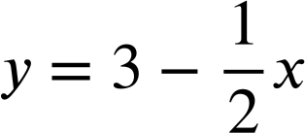
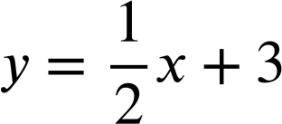
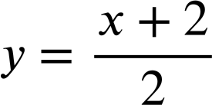
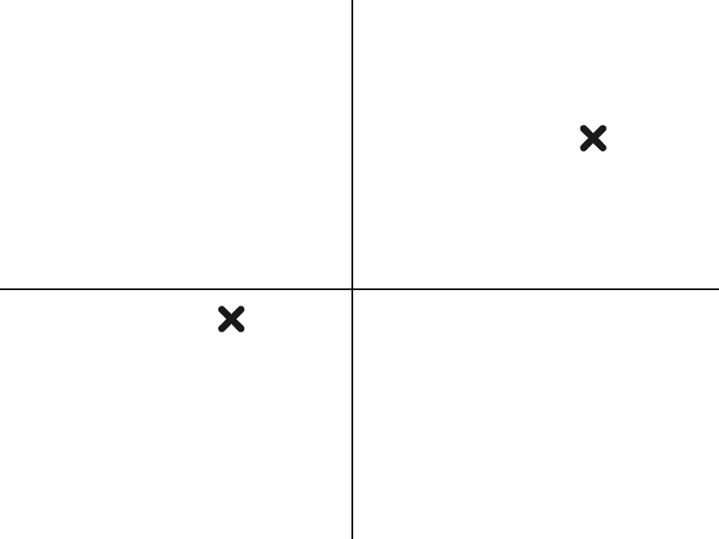
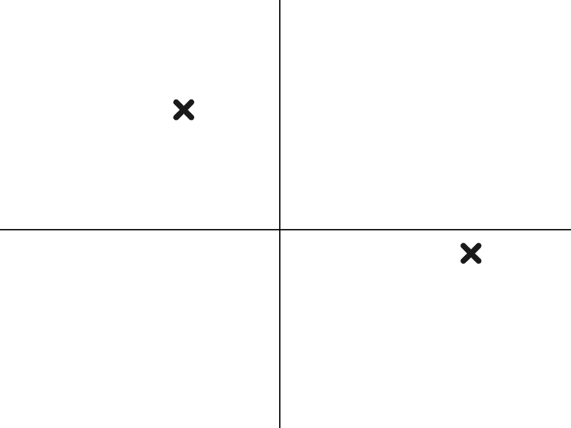
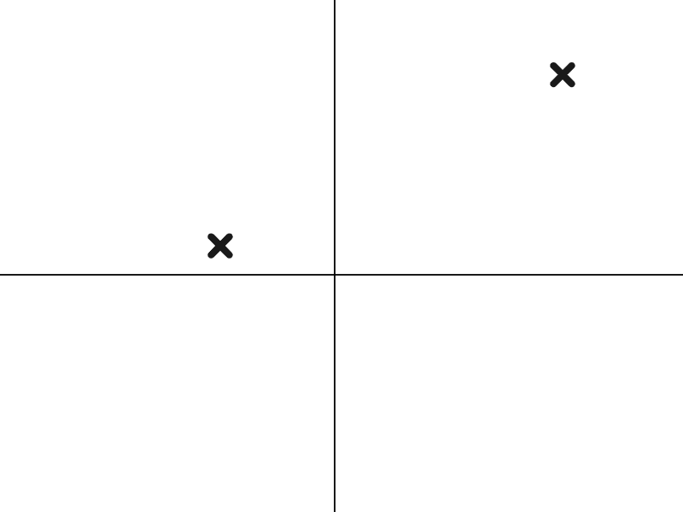
Graphical and algebraic representations
Match the coordinate pairs to their respective relationships and graphs.
A (−4, 1) and (8, 7)
B (−4, 5) and (8,−1)
C (−4,−1) and (8, 5)
D
E
F
G
H
I

Slide 35
Graphical and algebraic representations
Match the coordinate pairs to their respective relationships and graphs.
F
D
E
C (−4,−1) and (8, 5)
B (−4, 5) and (8,−1)
A (−4, 1) and (8, 7)
Matching coordinates to quadrants is a good place to start.
G
H
I

Slide 36
Features of linear relationships
Linear relationships, when plotted on a pair of axes, form a straight line.
Example, y = 7x + 3 is linear.
Non-example, y = 7x³ is not linear.

Slide 37

© Oak National Academy 2023.
Produced in partnership with Mathematics in Education and Industry.
Licensed on the Open Government Licence v3.0, except where otherwise stated. See Oak terms and conditions.

